Slide 1


Propel Efficiency: Revitalizing Gentech’s Proposal Process
Team 390 NexusBlend |
Ganesh, Sai Karun, Minghao Liu, Xuanyu Wang, Jason Chang
Notes:
I'm Charlotte, and today I'll be walking you through Gentech's initiative to enhance proposal process. Our goal is simple: 'Propel Efficiency'. We'll examine our current approach, pinpoint areas for improvement, and outline steps to increase our effectiveness. Let's get started.

Slide 2





MEET OUR TEAM
Ganesh
Xuanyu Wang
Jason Chang
Minghao Liu
Sai Karun
Notes:
we are the nexusblend, a group of business analysts working for Gentech on this case.

Slide 3





DEFINE
Define GenTech’s issue
MEASURE
Quantify the issue
DMAIC
ANALYZE
Identify the cause
IMPROVE
Address the underlying problem and confirm enhancements
CONTROL
Sustain the improvement and strive for excellence
Notes:
Our entire process takes the steamline DMAIC approach for structured process improvement.

Slide 4
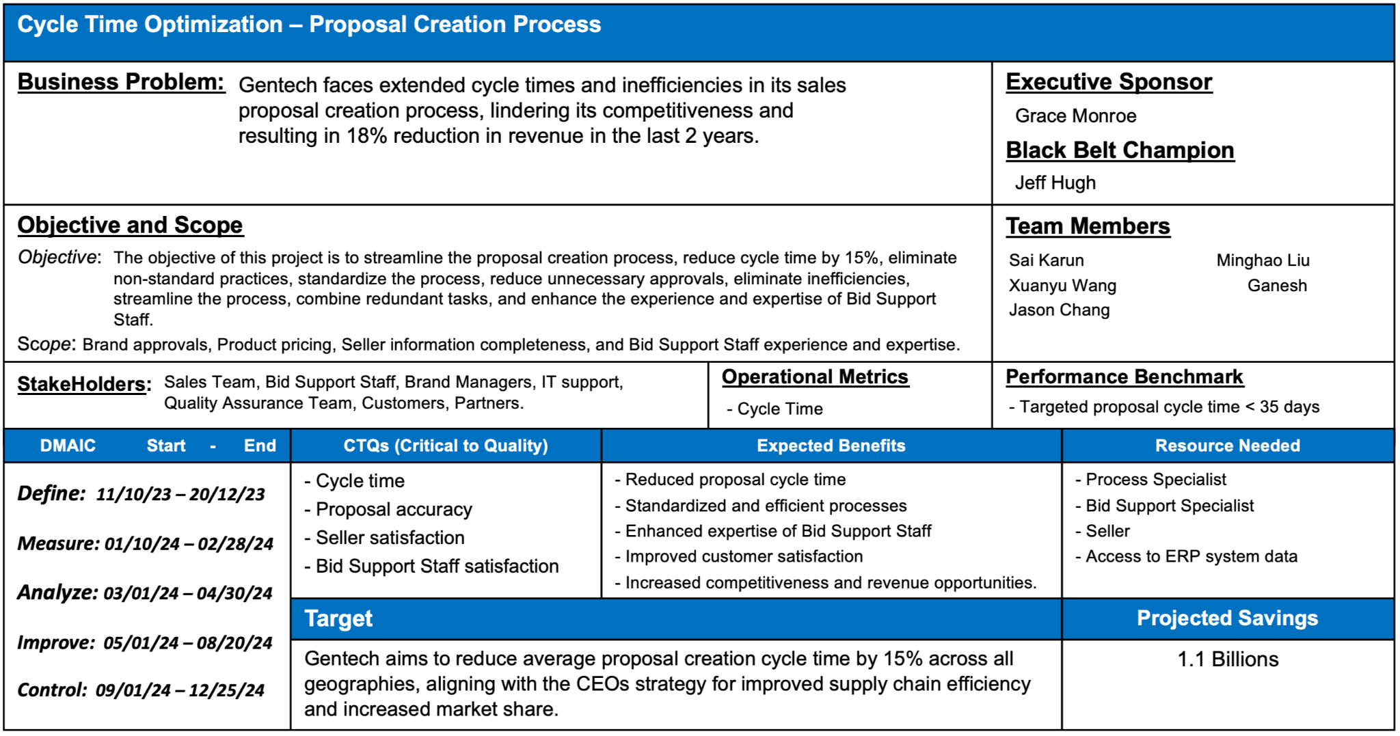
PROJECT CHARTER

Slide 5
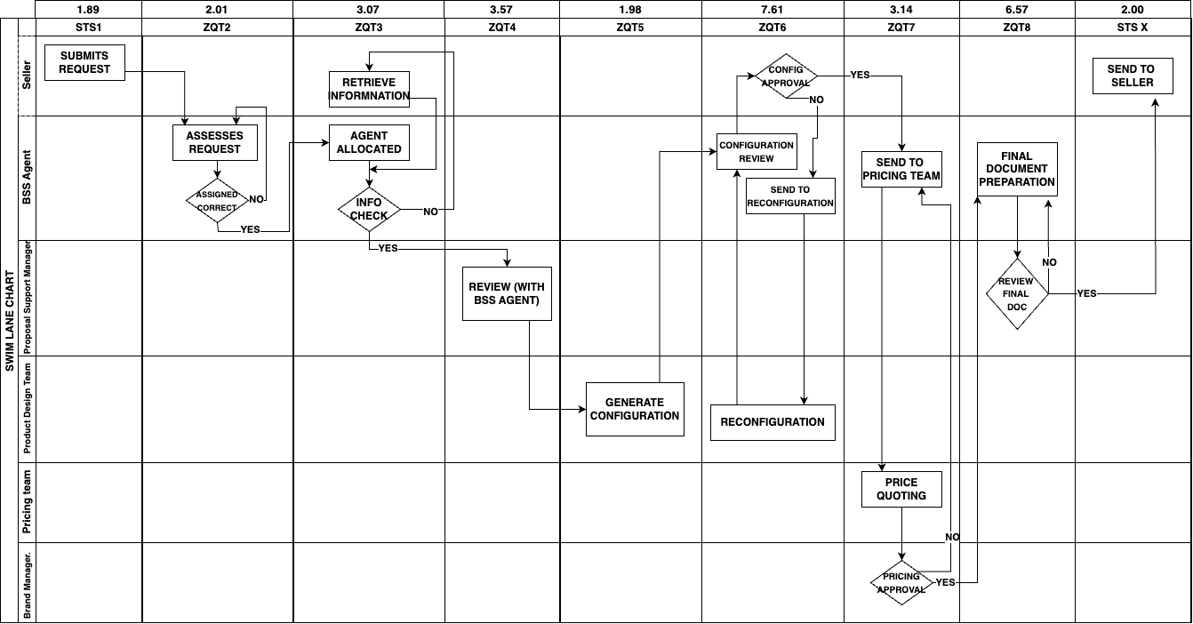
SWIM LANE CHART
Notes:
Process starts by seller placing a request and bss agent processes the req.
Then it goes to project manager for approval
Aft that configuration and reconfig are done and then goes to pricing team
Finally aft the brand manager s approval , bss agent sends it to seller again
In the whole process BSS agent is involved and he is the only point of contact with seller

Slide 6
PROJECT GOAL
PRESENT
Defects = 4600
Opportunities = 250000
DPMO = 18400
Process Sigma level = 3.6
REACH
Defects = 5418
Opportunities = 250000
DPMO = 21671
Process Sigma level = 3.5
FOR CYCLE TIME TO BE REDUCED BY 15 %
This would take us a bit close to Six Sigma Quality
Notes:
This is the quantitative objectives we want to achieve

Slide 7
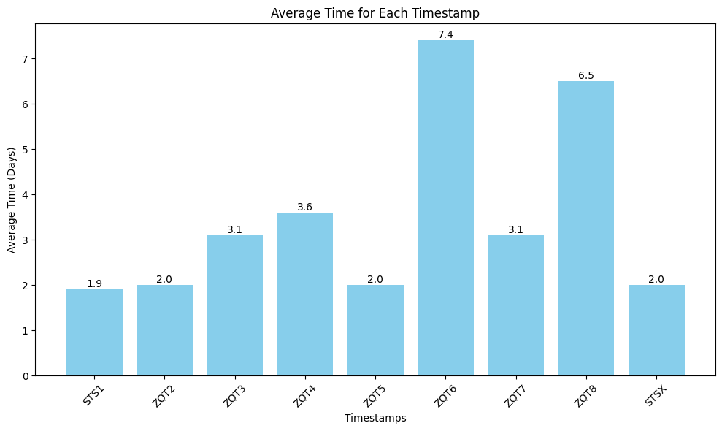
Average time in each Time Stamp
ZQT6 & ZQT8 appears to be the main cause for the long cycle time.
Are they really??
Notes:
We aim to reduce our defect rate. To achieve this goal we want to find if there have any process we can improve for reducing cycle time. Our data shows ZQT6 and ZQT8 have higher average times. However, longer times don't automatically mean inefficiency, as some steps naturally take longer. It's essential to consider this before concluding that ZQT6 and ZQT8 are solely responsible for delays.

Slide 8
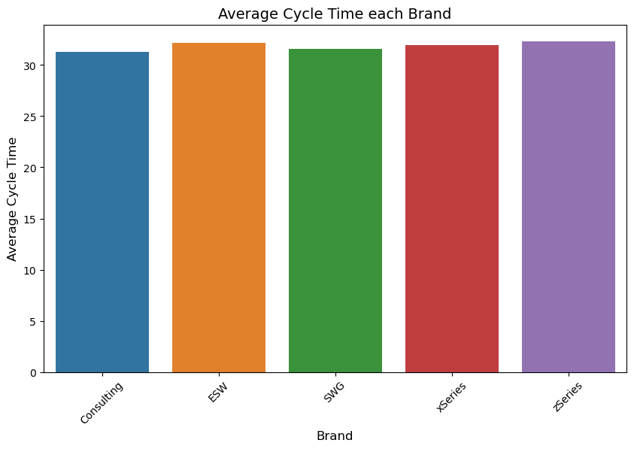
Does Brand have an impact?
Brand doesn’t look to affect average cycle time.
Notes:
We compared different brands to see if they affect average times. Our findings indicate that the brand choice does not significantly impact delays.

Slide 9
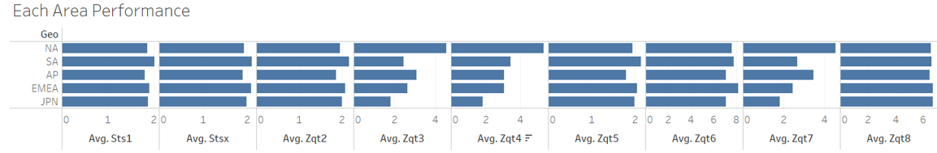
Regional Performance in each Time Stamp
ZQT 6 & 8 are high for all regions. They might be naturally high
The variations are more visible in ZQT3, ZQT4 and ZQT7
SO LET’S DIVE DEEP INTO THESE
Notes:
In our next analysis, we compared performance across different areas. We observed there are significant variations in processes ZQT3, ZQT4, and ZQT7, with Japan outperforming North America in these processes. This suggests Japan may be employing different methods that effectively reduce time spent on ZQT3, ZQT4, and ZQT7.

Slide 10
How do we Check if there are any delays in each process?
Cycle time > average cycle time
Retrieve the delayed data
Check which process caused the delay
Use 95% interval to see if the time spent on the process is over the upper limit (two sigma)
Compare which process caused delays frequently
Calculate the delayed frequency of each process
Count the spent time over the range of two sigma
Notes:
After examining area and brand factors, we shifted focus to individual processes to identify the causes of delays. Our approach involves analyzing data where the cycle time exceeds the average. This helps us identify areas for improvement. We calculate a 95% confidence interval for each process and check if the time spent in a delayed transaction exceeds this upper limit. Exceeding this limit indicates excessive time spent in a process, potentially causing overall cycle time delays. Additionally, we assess the frequency of delays in each process to determine which ones are more likely to causing total cycle time delays.

Slide 11
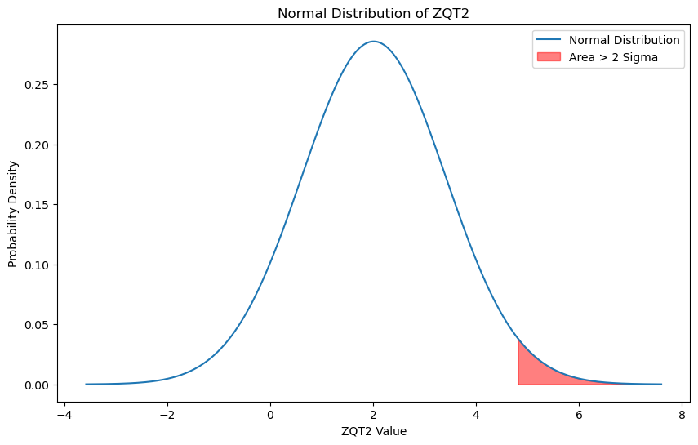
Example
Notes:
Take ZQT2 as an example: its mean value is 2. We calculate its 95% confidence interval to identify instances where the time spent on ZQT2 exceeds the upper limit, or two standard deviations (2 Sigma). Each time it exceeds this limit, we count it as one instance. By totaling these counts, we can quantify how often ZQT2 contributes to overall delays.

Slide 12
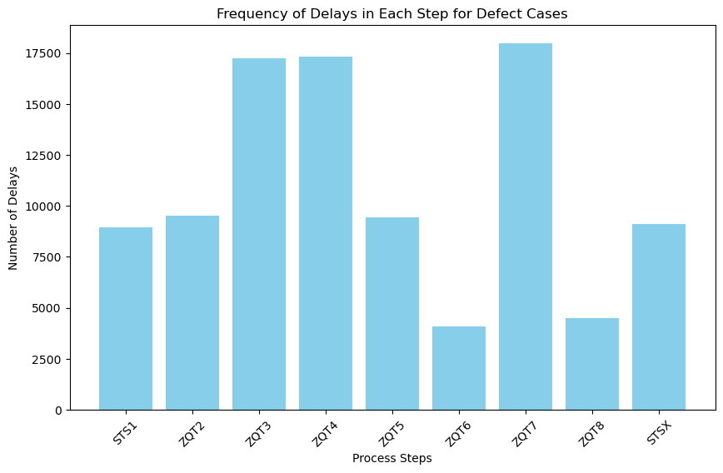
After analyzing what we found…
The Number of delays corresponds to the number of times the corresponding Time stamp falls outside (rightside) the
2 sigma range
Notes:
Our analysis revealed that ZQT3, 4, and 7 frequently contribute to overall cycle time delays. This finding aligns with our earlier area-based analysis. So, we believe that there must have some problem in these three region, possibly influenced by regional differences. Next part, we will closely examine these three processes to understand the causes of their frequent delays.

Slide 13
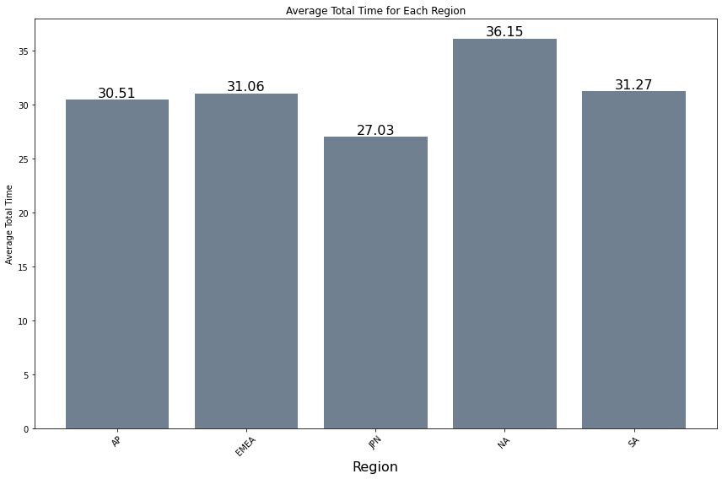
Geographical Influence on cycle time:
Bid Size stats:
Geo | AVERAGE | Q1 | Q2
AP | 57293 | 41250 | 59989
EMEA | 56207 | 46148 | 65856
JPN | 42338 | 38101 | 47201
NA | 83733 | 52468 | 110872
SA | 57996 | 45416 | 67997
?
NA accounts for highest Bid sizes.
For NA, Tight measures to reduce cycle time might lead to losing high bids.
NA - Highest Cycle time
So, should we look to reduce cycle time in NA ?

Slide 14
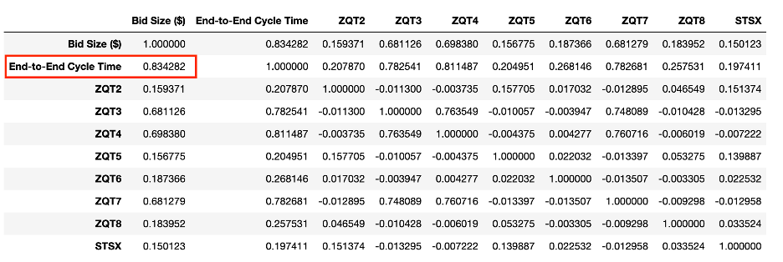
Impact of Bid Size
Strong correlation between Bid Size and Total cycle time
Important to take Bid size into account before making recommendations just by looking at the High Average Cycle times in ‘NA’

Slide 15
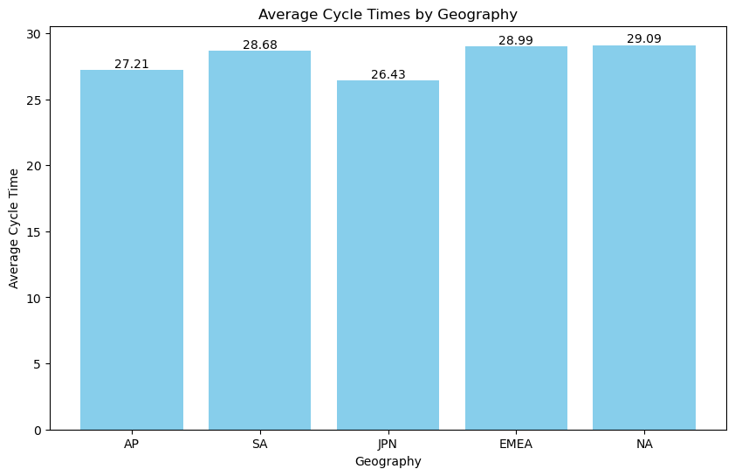
AVERAGE CYCLE TIMES FOR SIMILAR BID SIZES ACROSS REGIONS
For each region the Bid Sizes are different
Unfair to compare the Total cycle times
Compared each region for the same Bid Size Range
All regions perform same in this range
Cannot expect a drastic improvement in efficiency by just focusing on region with high average cycle time
Notes:
Since we found out that bid size has a huge impact on causing delays, which makes sense, we also want to analyze if it is indeed, the difference of bid size is the main cause of the performance variety in among different regions. So we will take on a hypothetical approach. We set the bid size of the transactions to be constant among all regions, and then re-calculate their average cycle time. If their average cycle time still vary drastically, there might be some other factors that we need to monitor. And it turns out, that once we set the bid size constant, the average cycle time suddenly become somewhat similar. This is an indication that bid complexity is indeed the major factor that affects the process performance

Slide 16
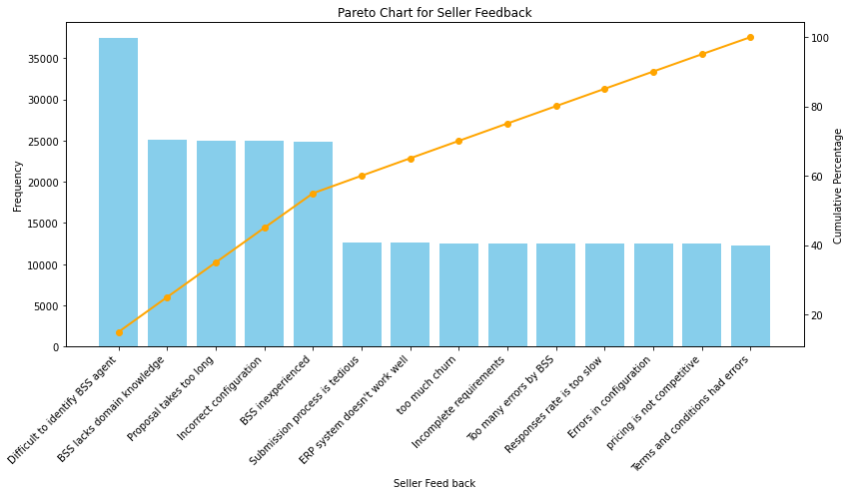
Top Feedbacks:
Difficulty in communication
Inexperienced/
Incorrect BSS
Incorrect configuration
Most of these are issues related to
BSS agents.
SELLERS FEEDBACKS

Slide 17
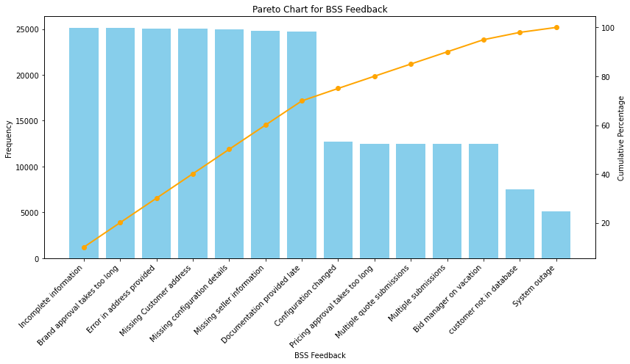
Top Feedbacks:
Missing information
Most of them are related to errors in information
Most of these are related to issues with Sellers
BSS AGENT FEEDBACKS

Slide 18
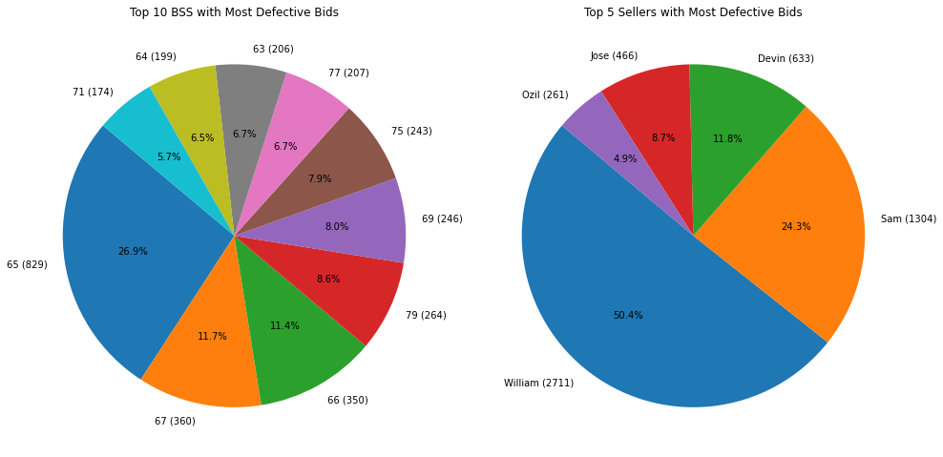
TOP BSS AGENTS & SELLERS INVOLVED IN DEFECTS
Notes:
William from North America performs extremely poorly

Slide 19

Very high percentage of the collaborations between the
Top 2 pairs led to defects.
The potential causes might be:
Lack of clear instructions about bid details.
Inefficient or unclear channels for communication and query resolution.
BSS AGENT - SELLER PAIRS INVOLVED IN DEFECTS
BSS | Seller | Defects | Total_Collaborations | Defect_Proportion
65 | William | 452 | 513 | 88.10%
65 | Sam | 376 | 522 | 72.00%
67 | William | 233 | 646 | 36.10%
66 | William | 232 | 760 | 30.50%
79 | William | 188 | 649 | 29.00%
17 | Jose | 170 | 391 | 43.50%
69 | William | 166 | 631 | 26.30%
75 | William | 165 | 648 | 25.50%
63 | William | 155 | 627 | 24.70%
77 | William | 150 | 648 | 23.10%
Is Communication the Core Issue?
Are there other causes for long cycle times?

Slide 20


CAUSE ANALYSIS
Long ZQT7
Long ZQT8
Long ZQT4
BSS inexperienced
Complexity
Brand approval takes too long
BSS lacks domain knowledge
BSS inexperienced
BSS lack of domain knowledge
Complexity
Long cycle time
Complexity
Missing info
Incorrect Configuration
Missing configuration detail
Error in address
Long ZQT6
Long ZQT3
Notes:
Now that we see some of the possible reasons for delay, we want to relate it back to the problem itself, drawing connections between these reasons and the delay in some of the process we want to monitor. And even though ZQT6 and ZQT8 should be taking a long time to process, we are still interested to learn what might cause them to take this long

Slide 21

FMEA
Error in address provided
S O D
Complexity 10 x 10 x 5 = 500
Error in address provided 8 x 8 x 5 = 320
Missing seller info 8 x 7 x 5 = 280
BSS lacks domain knowledge 8 x 6 x 5 = 240
Missing customer address 8 x 5 x 5 = 200
BSS inexperienced 8 x 4 x 5 = 160
Missing configuration detail 10 x 3 x 5 = 150
Difficult to identify BSS 5 x 9 x 3 = 135
Brand approval takes too long 8 x 2 x 5 = 80
Incorrect configuration 10 x 1 x 5 = 50
Notes:
Now we take these reasons and rank them by their RPN scores to determine the urgency levels

Slide 22
Optimising Cycle time with immediate effect
Recommendations
Long term Optimization

Slide 23
Immediate Next Steps
When the data is sliced based on the bid size range falling in the 2 std range of Japan for every region we observe similar process times
Keeping Bid Size constant and observing process times for each step we can aim to achieve and overall reduction of 9% in the cycle times
This implies by simply implementing the learning from other regions we can immediately optimise the cycle by 9%
When broken down into timestamps below are the improvement for each process that can be achieved
It is important to note that in ZQ3, ZQ4 and 7 huge improvements can be made which significantly contribute to overall efficiency
9%
3.16%
5.37%
21.11%
30.84%
8.05%
7.96%
20.75%
1.15%
3.27%
ZQT2
ZQT5
ZQT6
ZQT8
STS1
ZQT3
ZQT4
ZQT7
STSX

Slide 24
Recommendations to further optimize the process on the long run
01
ERP System Optimization
Upgrade or replace the current ERP system to address reported performance issues.
Integrate real-time validation for data completeness to reduce the number of incomplete requirements and errors in submissions
02
Training & Development
Implement comprehensive training programs to enhance BSS's domain knowledge and understanding of common errors in configuration.
Create a mentorship program where inexperienced BSS can learn from senior agents.
03
Automated Routing & Matching
Use an automated system for intelligent routing of requests to appropriately skilled BSS agents.
Implement a feature for Sellers to flag urgent requests and ensure they are prioritized accordingly.
04
Response Time Improvement
Set up Service Level Agreements (SLAs) to standardize response times and improve accountability.
Monitor response times and provide regular feedback to BSS to improve their response rates.
05
Process Streamline & Standardization
Simplify the submission process with a user-friendly interface and clear step-by-step guidance.
Create standardized templates and checklists for Sellers and BSS to minimize errors and omissions.

